Slide 1
Team Name :- Cloud Hackers
Theme :- Healthcare

Slide 2
Team Details
Team Leader
Ayush Gupta
Team Members
Neeraj Lodhi
Vinit Sheetal
Nikshay Yadav

Slide 3
Problem Statement
An AI-based diagnostic tool that can analyze medical images (e.g., X-rays, MRIs, CT scans) to assist doctors in detecting diseases like cancer, pneumonia, or fractures more accurately and swiftly.

Slide 4
Understanding the problems
01
The AI tool uses advanced algorithms to analyze medical images like X-rays, MRIs, and CT scans, identifying patterns and anomalies that might indicate conditions such as cancer, pneumonia, or fractures.
Unlike traditional manual analysis, which can be time-consuming, the AI-based tool quickly processes and interprets medical images. This speed allows doctors to provide timely diagnosis, which can be crucial in cases where early detection significantly impacts treatment outcomes.
02
The AI tool acts as a supplementary aid to doctors, providing a second opinion or highlighting areas of concern that require further attention. It doesn't replace medical expertise but instead supports healthcare providers, helping them make more informed decisions and improving patient care quality.
03

Slide 5
Steps
Data Collection
Machine Learning Models
Annotation & Labeling
Validation & Testing
Clinical Integration
Regulatory Compliance
User Interface
Continuous Learning

Slide 6
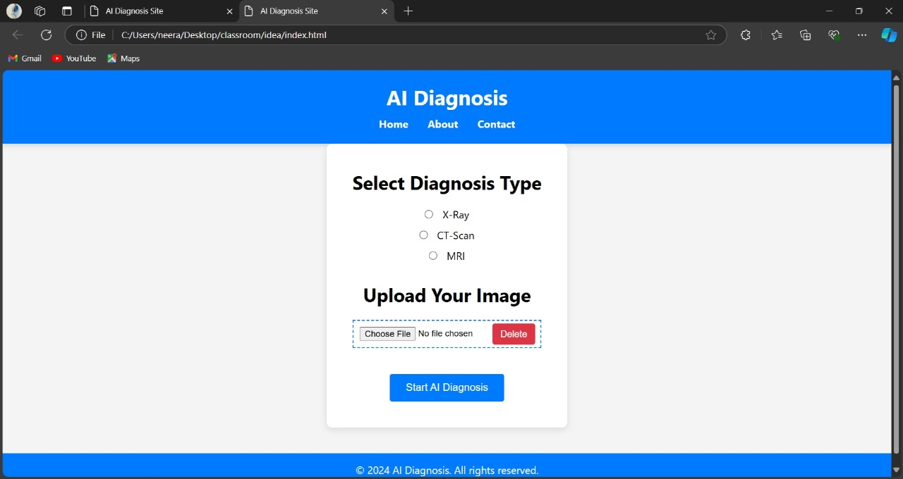
This code loads a pre-trained model and uses it to predict whether a given image (e.g., an X-ray) shows a fractured bone. The image is preprocessed, normalized, and then passed through the model for prediction. The output is either "Fractured" or "Healthy" based on the prediction score

Slide 7
key Features of our Solution
Key Partners
04
Key Activities
Diagnostic Centers Hospitals with Radiology
AI Developments and Maintenance
Partnership Management
01
03
Value Propositions
Customer Relationships
Accuracy and Reliability Efficiency
02
Training and Education Dedicated Support

Slide 8

Thank you!

